Slide 1

LEARNIX WEB SITE
BY: Codex Team

Slide 2
PROJECT IDEA
Proplem :
Students need an easy online learning platform, and instructors need a simple way to upload and organize courses.
Most existing platforms are complicated or expensive.
proposed solution :
Create Learnix, a clear and easy-to-use e-learning platform where instructors can upload courses and materials, and students can browse, purchase, and learn comfortably.
The system uses simple role-based access (Student – Instructor – Admin).
Unique value proposition :
Very easy for both students and instructors
Simple and organized course structure
Affordable alternative to big platforms

Slide 3
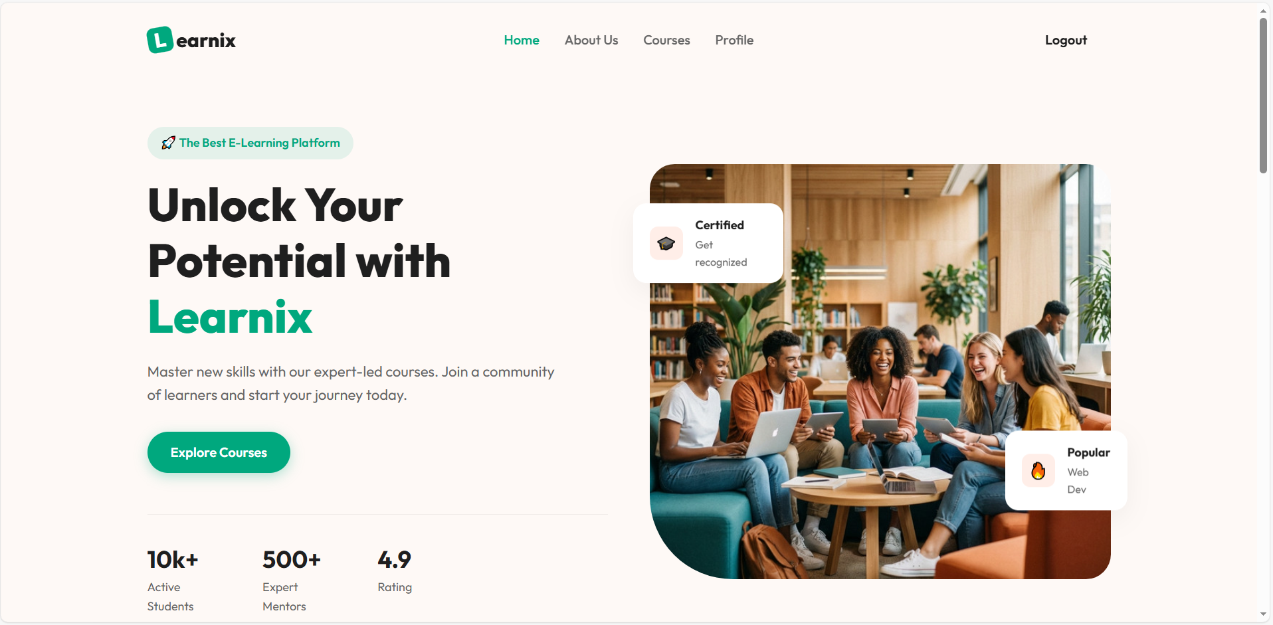

Project Wireframe
Visual Representation
Wireframes show the basic layout of Learnix pages such as:
Homepage (course browsing, categories, login buttons)
Student Dashboard (enrolled courses, progress)
Instructor Dashboard (create / manage courses)
Admin Dashboard (Manages users + courses, and platform data.)

Slide 4
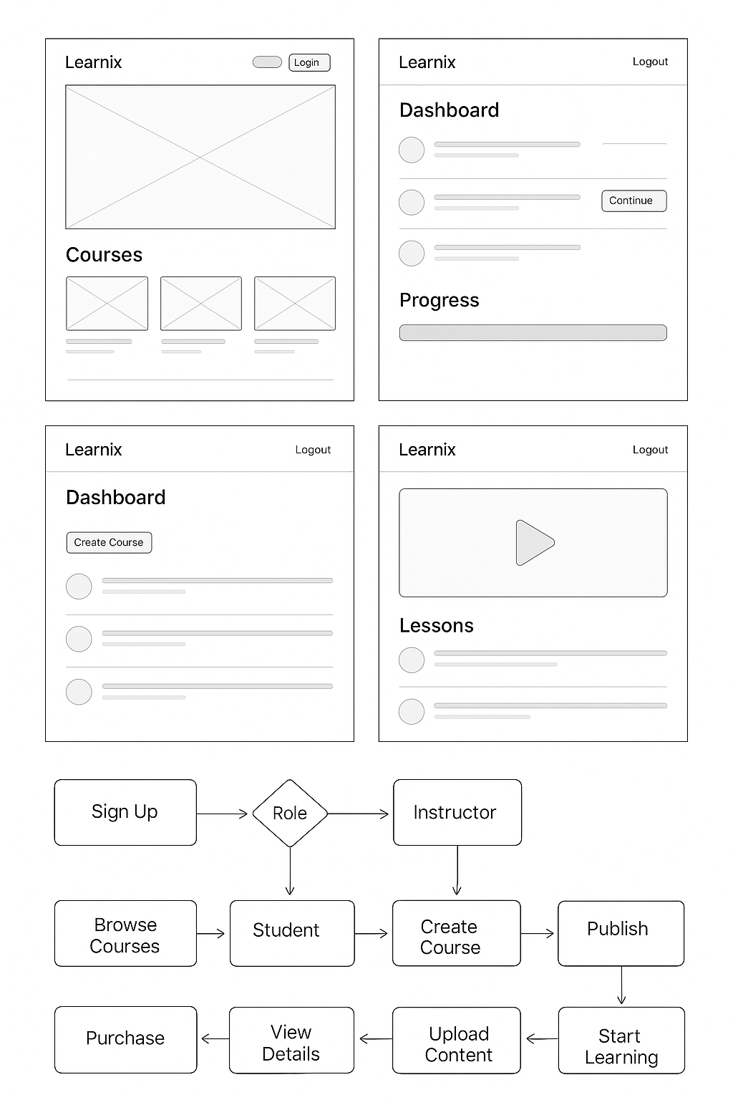
Project Wireframe
User Journey (Overview)
User Onboarding:
The user signs up → selects role (Student or Instructor).
Core Experience:
Student: Browses courses → views details → purchases → starts learning.
Instructor: Creates course → uploads videos/materials → publishes.
Admin: Manages users, courses, and platform data.
This journey explains how each user interacts with the platform from start to finish.

Slide 5
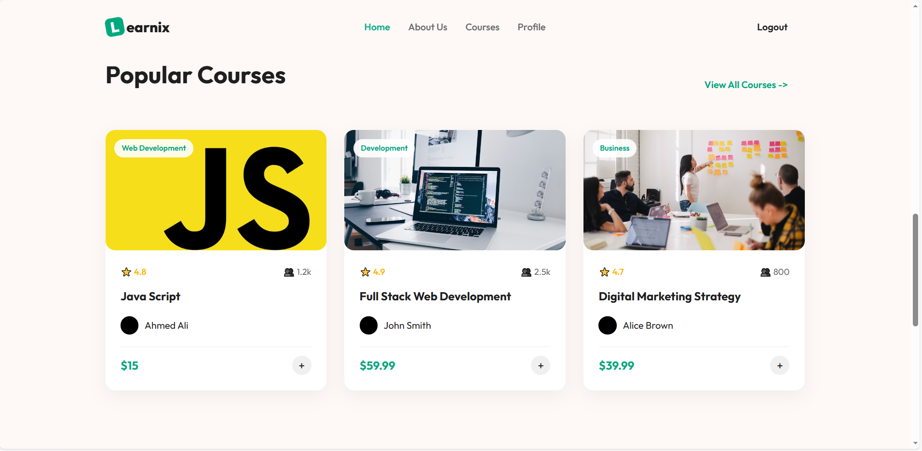
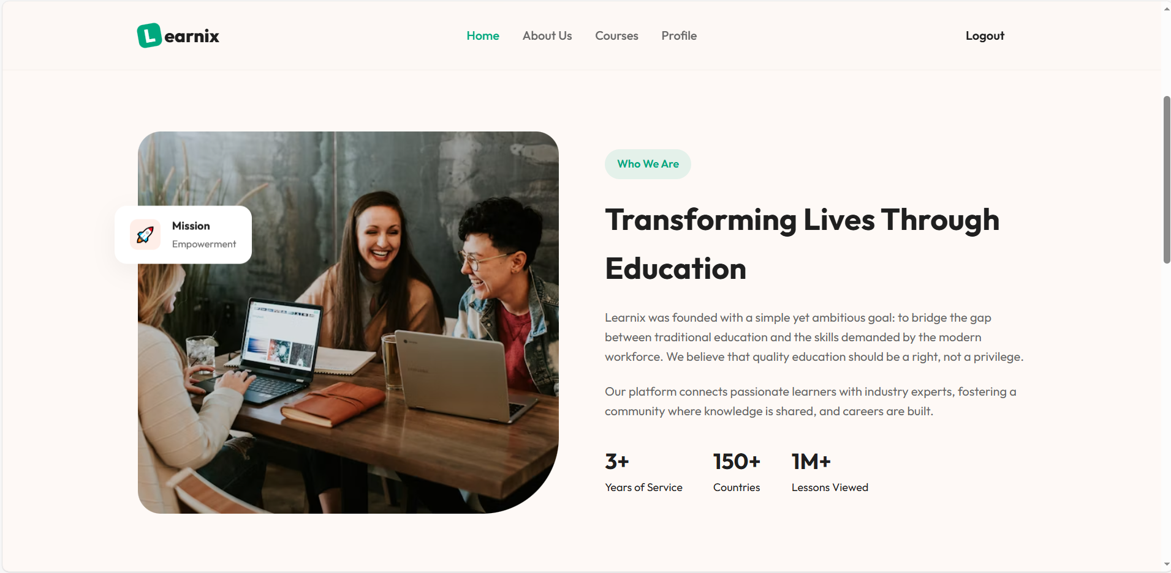
Project Wireframe
Simple and clean interface
Easy navigation between pages
Focus on UX / Usability
Clear buttons and instructions
Organized course structure

Slide 6
End Users + Features
Browse courses , View course details , Watch video lessons , Track learning progress
👨‍🎓 Students
Easy browsing → Helps them quickly find the right course
Progress tracking → Stay organized while learning
Create and manage courses, Upload videos and files , Organize lessons into sections , Publish/unpublish courses
👨‍🏫 Instructors
Simple course builder → No technical skills required
Upload materials easily → Helps them share knowledge instantly
Manage users , Approve instructors , Manage courses and platform data
🛠 Admin
User & course management → Keeps platform safe and organized
Content moderation → Ensures quality learning materials

Slide 7
Data Structure
1. Database Architecture
Type : Relational database (SQL Server)
Organization : Tables with rows (records) and columns (attributes)
Features : Maintains data integrity with primary & foreign keys, supports structured queries
2. Data Flows
Collection: Users register, enroll, and complete courses → data captured via web forms
Storage: Structured in relational tables
Access: Retrieved via SQL queries, ORM (Entity Framework)

Slide 8
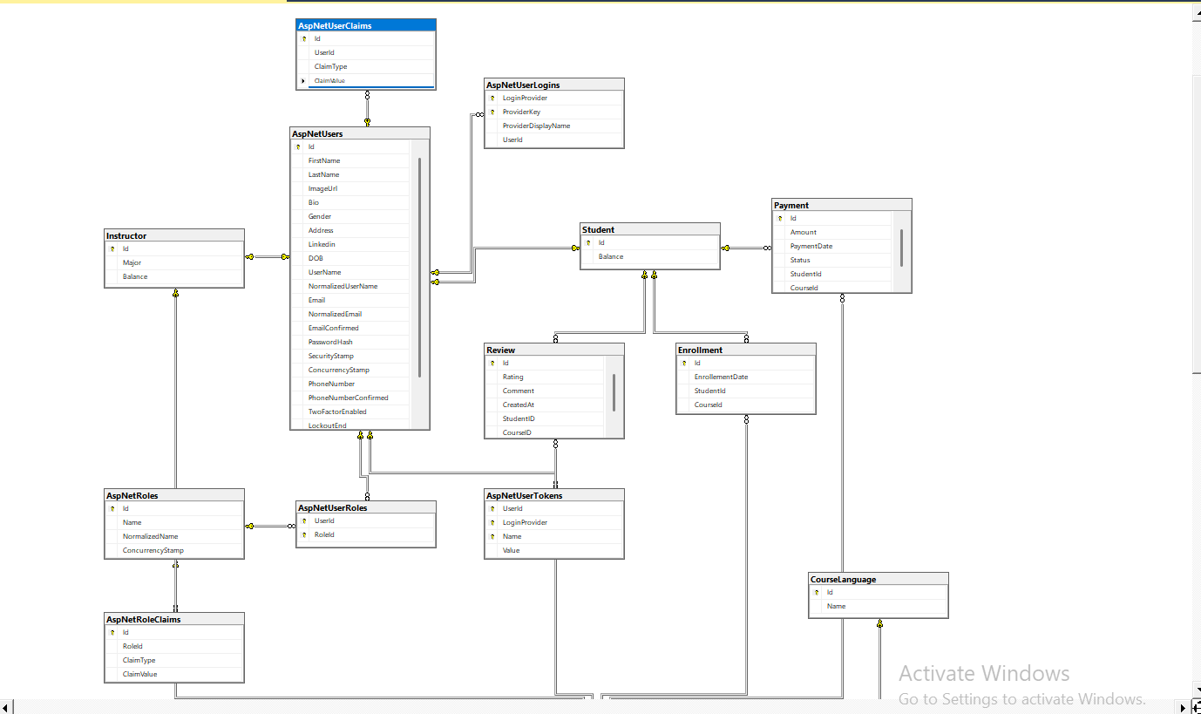
Data Structure
3. Key Entities & Relationships

Slide 9
Programming Languages & Frameworks
1. Main Programming Languages:
C# – Backend development
HTML / CSS / JavaScript – Frontend structure, styling, and interactivity
SQL – Database management and queries
2. Frameworks & Tools:
.NET MVC – Backend web framework
Entity Framework – ORM for database operations
3. Supporting Technologies:
SQL Server – Relational database management
Visual Studio – Development environment

Slide 10
Live Application + Testing
1. Live Application Status
Current State: Beta version of Learnix is live
Environment: Hosted on a test server (local or cloud)
Features Available: User authentication (Admin, Instructor, Student) , Course creation & lesson uploads , Enrollment and content access , Admin dashboard
2. Testing Phases
Unit Testing: Developers tested individual components (controllers, services, models) , Ensures each method is working
Integration Testing: Verifies how modules interact (e.g., enrollment + payment, course + lessons)
User Acceptance Testing (UAT): Students and instructors tested the platform
Performance & Security Testing: Tested load time, server response, and data security

Slide 11
Deliverables (Reports)
1. Reports & Documentation Provided
Technical Specification Document: System architecture, database design, APIs, security
User Manuals: Guides for Admin, Instructor, and Student
2. Timeline for Deliverables (Milestones & Deadlines)
Milestone | Deadline | Description
Requirements & Planning | Week 1 | Scope, user stories, diagrams
Database + System Design | Week 2 | ERD, UML, architecture
Core Development | Week 3 – 4 | Backend + Frontend features
Testing & Bug Fixing | Week 5 | Unit, integration, UAT testing
Final Documentation + Demo | Week 6 | presentation, final review

Slide 12
Deliverables (Reports)
3. Final Products Delivered
Fully working Learnix e-learning platform
Source code repository (GitHub or GitLab)
Database schema & backup file
Admin dashboard, Instructor panel, Student dashboard

Slide 13
Project Team
Team members :
Member 1
Abdelrahman Amr Abdelnaby Meselhy
Member 2
Mohamed Yasser Salah Elnagar
Member 3
Mohamed Atef Mohamed Abu Yousef
Member 4
Abdelaziz Ahmed Saad Aresha
Member 5
Ahmed Mostafa Albehery

Slide 14
Project Team
Team Roles :
Abdelrahman Amr
Instructor Dashboard, Enrollments, Authentication & Authorization
Student Dashboard
Mohamed Yasser
Mohamed Atef
Student Dashboard
Admin Dashboard
Abdelaziz Ahmed
Ahmed Mostafa
Admin Dashboard , Course Page

Slide 15
Thanks

